Slide 1
Imagine Cup Junior
Lesson Five – How to make sure your AI is good and cyber safe
Notes:
This is a title slide that you can have up at the beginning of Lesson 5 of the Imagine Cup Junior.

Slide 2

Challenge Check-in
What have you done so far?
You formed a team and identified a specific problem from one of the AI for Good categories. You have formed a team, selected a problem and learned more about it.
You have learned about the basics of AI, what generative AI is, and how to build with APIs.
You are now AI inventors dreaming up your AI concepts to submit to Imagine Cup Junior!
What is next?
In this lesson you will learn about the ethics of AI and cybersecurity to ensure your AI is for good and is cyber safe.
Notes:
Challenge check-in. This slide is a check-in to recap what the students have learned and what is coming next!

Slide 3






What we will be doing across the six Imagine Cup Junior lessons.
Lesson 1
Lesson 2
Lesson 3
Forming your team and choosing your problem.
Learning about how AI works.
Learning about generative AI.
Lesson 4
Lesson 5
Lesson 6
Becoming a team of AI inventors.
Making sure your AI is good and cyber secure.
Entering a great submission to Imagine Cup Junior.
Notes:
This slide provides a short overview of the six lessons your class will take part in.

Slide 4
Submission Tips
Imagine Cup Junior is about applying the worlds most powerful technology to to do good and help solve social and environmental challenges. And it’s important to keep users and information safe. To do well in the ethics and cybersecurity section you need to:
Identify possible negative impacts with your idea and innovate improvements.
Convince the judges that you have met the AI ethical principles.
Identify how your team will reduce cybersecurity risks.
Notes:
Slide 4: Here are some tips for your students to consider to ensure they are putting in a great submission. Submissions should include clear explanations of alignment to the ethical principles and how they will reduce cyber security risks.

Slide 5

What do you think are some really great things that technology has brought to the world in recent history? What do you think have been the biggest, most positive or important technological shifts so far this century?
Rapid Reflection
Notes:
Rapid Reflection – To engage your students with this lesson, ask them to work in their teams (or as a whole class) to brainstorm some really great things technology has brought to the world.

Slide 6
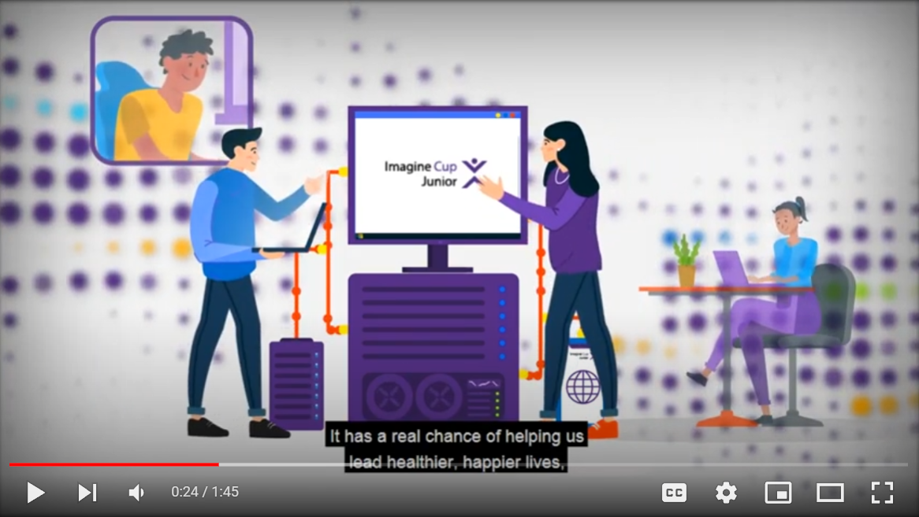

Anticipating and Mitigating Negative Impacts
Anticipating and Mitigating Negative Impacts | https://youtu.be/ZvWeTBHHkKg
Notes:
Video 1: Anticipating and Mitigating Negative Impacts. Here we have a video on the possible negative impacts of new technology.

Slide 7

Sprint 1
Identifying Negative Impacts
Sprint 2
Making your AI Ethical and Cyber Secure
Sprint One – Identifying negative impacts.
Goals:
As a team, identify any negative impacts your idea could have. Make improvements to minimize negative impacts.
Maybe some of these are small issues, maybe some of them are much larger. As a team, see what you can uncover.
Hints:
Some questions you might ask as a team when identifying negative impacts might be ‘how could our idea affect the environment?’, ‘could our idea be taken and used in a negative way?’, Are there any changes you can make to minimize the negative impacts of your idea?
Notes:
Sprint One – In the first ten-minute sprint of Lesson Five your students can work in their teams to discuss the negative impacts of technology, and identify any negative impacts their idea could have. This sprint is to get students thinking about negative impacts before we learn about the ethics of AI.

Slide 8

Microsoft’s AI Principles
Microsoft's AI for Good Ethical Principles
Microsoft has 6 ethical principles that help AI inventors to create technology that is positive for the world. You will receive points the more that you can show that your AI concept aligns with these. Let's check them out!
Notes:
Your students have no doubt already come up with a great idea, and the benefits for the world will be positive if they were able to make this idea a reality. Ethics are a huge part of Imagine Cup Junior, and in particular the Microsoft AI for Good ethical principles are very important. Your students will see their scores go up or down by how well they engage with the 6 ethical principles.

Slide 9
Responsible AI
Responsible AI | https://youtu.be/KOT8sydez7c
Notes:
Video 2: In this video, students are introduced to Microsoft’s AI for Good Ethical Principles. Students will learn about the the ethics of AI, why they exist, and how they can make improvements to their idea to ensure they are ethical.

Slide 10
Submission Tips
- Teams that simply say 'Our AI is fair because it does not judge people' will not score as many points as those who are able to show some really good thought around the ethical considerations of their concept.
Notes:
Submission Tips. Really encourage your students to spend some time thinking about their team’s ethical statements. Teams that simply say 'Our AI is fair because it does not judge people' will of course not score as many points as those who are able to show some really good thought around the ethical considerations of their concept.

Slide 11
Example
Fairness:
We believe our AI concept is fair because our AI Interviewer does not make any hiring decisions based on appearance. The AI does not see a picture or video of the person, or even see their family name, so the AI is unable to make hiring decisions based on their racial or cultural background.
Notes:
Submission tips! It’s important that students explain how they meet the ethical principles. An example of an ethics statement is on this slide. Specifically, we have showed an example about fairness: Fairness: We believe our AI concept is fair because our AI Interviewer does not make any hiring decisions based on appearance. The AI does not see a picture or video of the person, or even see their family name, so that the AI is unable to make hiring decisions based on their racial or cultural background.

Slide 12
Choose one of the Ethical Principles to focus on jot down a couple notes about how your idea is aligned to that principle.
Rapid Reflection
Notes:
Rapid Reflection – In this rapid reflection, we ask the students to consider how one of the ethical principles is aligned to their idea so they can begin drafting their statements later in the lesson.

Slide 13

Introduction to Cybersecurity
Introduction to Cybersecurity | https://youtu.be/6eaY78V80aY
Notes:
Video 3: This is when we introduce the term cybersecurity. This is designed to prime your students to start to understand why cybersecurity is a big deal, and begin thinking about how their idea might have cybersecurity issues.

Slide 14
Which Ethical Principles do you think are most strongly with cybersecurity and why?
Rapid Reflection

Slide 15
Cybersecurity and Hacking
Cybersecurity and Hacking | https://youtu.be/Gt70vWYEk_8
Notes:
Video 4: In this video, we look at common cyber security risks, and the different tools hackers have at their disposal. This is designed for your students to learn about the different types of hacking risks and approaches.

Slide 16
Tips for Protecting Your AI
Tips for Protecting Your AI | https://youtu.be/dkbyq9XoZwI
Notes:
Video 5: In this video, we look at different ways we can protect the cybersecurity of our AI ideas. This is designed for your students to learn about the different types of protection tools, and to encourage them to include some of these ideas in their submission.

Slide 17
Cybersecurity Solutions
Recap of key practices for AI security
Run updates.
Device renewal.
Two factor authentication.
Secure from the start.
The AI can function offline.
Be careful with data.
Be transparent about your AI.
Hint:
These are the tools that are tried and tested but you shouldn’t feel limited by this list. Teams are encouraged to use creativity and truly innovate ways to reduce cybersecurity threats for AI.
Notes:
Recap and summary of the 7 ways to reduce risks in AI.

Slide 18
Submission Tips
When you look at the rubric you will see that for maximum points you need to be clear about the cybersecurity features you will use. Just saying ”we will run frequent updates” might not get you full points so try to include relevant details about frequency, hardware capabilities, and inconveniences to users when applicable.
Notes:
Slide 12: Submission tips: these tips are designed to help your students stay focused in this lesson, and ensure they are considering the cybersecurity elements of their idea. Encourage your students to use tried and tested tools to combat cyber risks, but also to be creative and come up their own. The emphasis here is to encourage specificity and details whenever possible in their explanation of how they will mitigate cybersecurity risks to their AI.

Slide 19
Sprint 1
Identifying Negative Impacts
Sprint 2
Making your AI Ethical and Cyber Secure
Sprint 2 – Drafting your Ethics and Cybersecurity statements
“We believe our AI idea is X because...”.
How will you reduce cybersecurity risks to your AI?
Cybersecurity tools
Run updates.
Device renewal.
Two factor authentication.
Secure from the start.
The AI can function offline.
Be careful with data.
Be transparent about your AI.
Notes:
Slide 14: Sprint Two – In the second ten-minute sprint of Lesson Five your students will work in their teams to begin drafting their Ethics and Cybersecurity statements. The ethics statement needs to explain how their concept aligns to each of the six ethical principles and the cybersecurity statement needs to explain how they have planned to reduce cybersecurity risks.

Slide 20
Challenge Check-in
What have you done so far?
You formed a team and identified a specific problem from one of the AI for Good categories and learned more about it.
You have learned about the basics of AI and how to build with APIs.
You learned about the Microsoft AI Principles and applied them to your idea to.
You learned about cybersecurity and have taken steps to ensure your AI invention in cyber safe.
What is next?
Up next is the last lesson and it is designed to help your team complete the final preparations to submit your entry to Imagine Cup Junior.
Notes:
Slide 15: Challenge Check-in – This is a quick moment to recap what your students achieved in Lesson 5.

Slide 21
Bonus Activities!
Have a class debate around this question:
Will AI make the world more inclusive? Discuss.
Here are a few things you can look at to inform the debate:
AI, Ain’t I a Woman? Creating a more inclusive society through the power of AI
In pursuit of inclusive AI
As a class watch this video of a car being hacked remotely.
Hackers Remotely Kill a Jeep on the Highway—With Me in It | WIRED
What surprised you in the video?
Do you think this was an ethical experiment?
Notes:
Bonus Activities –
Option 1: Have a class debate around the question ‘AI will make the world more inclusive’ - discuss. Here are some links the students can look at and get the debated started: AI, Ain’t I A Woman?; In the Pursuit of Inclusive AI; Creating a more inclusive society through the power of AI.
Option 2: If your students have enjoyed this lesson, they may want to watch this video of a car being hacked remotely. As a class, discuss what surprised you in the video, and whether the students think this was an ethical experiment? Link: Hackers Remotely Kill a Jeep on the Highway | Wired

Slide 22
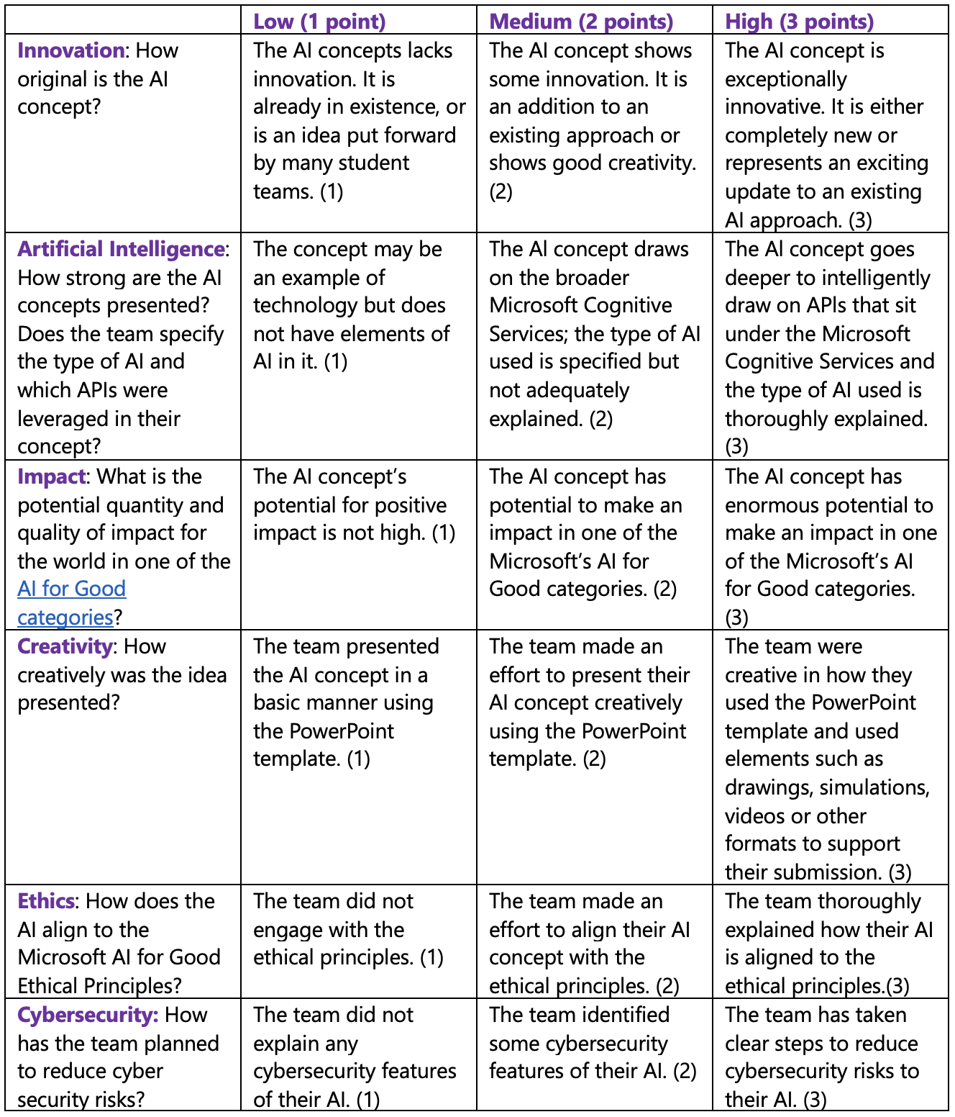
Judging Rubric
This is the rubric used by the judges to assess your student’s submissions. You can share this with your class and use it to guide their AI concepts as they fill out their PowerPoint Submission Template.
Notes:
Judging Rubric - This is the rubric used by the judges to assess your student’s submissions. You can share this with your class and use it to guide their AI concepts as they fill out their PowerPoint Submission Template.

